Slide 1





Slide 2

AGENDA
I. Aura Orientalis Introduction
II. System Introduction
1. Key Solution Advantages
2. Key Customer Engagement Advantages
3. Key Teachnical Advantages
III. AOI SORA
1. Demo
2. Schedule
3. Cost

Slide 3

I. Aura Orientalis Introduction
Our vision is for everyone to live happily through a comfortable environment and a calm mind and body.
① PRODUCTS
③ WEB & MOBILE PLATFORMS
② TRADE/B2B
④ STRATEGIC & SUCCESS SUPPORT

Slide 4

II. System Introduction
1. Key Solution Advantages
Solution Capabilities Beyond Outsourcing
Solution Proposal: Provide optimal solutions instead of only coding on request.
Product Development: Transform requirements into customer fit products, not just deliverables.
Continuous Improvement: Enhance products based on real customer needs and experiences.
Solution Services

Slide 5

II. System Introduction
2. Key Customer Engagement Advantages
Clear Communication, Strong Partnership
Deep retail experience: Strong understanding of customer needs.
Practical & effective support: Maintain connection and assistance with customers.
Long-term partnership: Not only providing systems but accompanying customers in growth.

Slide 6

II. System Introduction
3. Key Technical Advantages
Partnering with experienced outsourcing company
Strategic Partnership: Partnered with TORA TECH for sustainable growth.
Seamless collaboration: Ensuring stable quality through close teamwork.
Fast execution: Code fixes and screen changes in a very short time.
IT Outsourcing

Slide 7
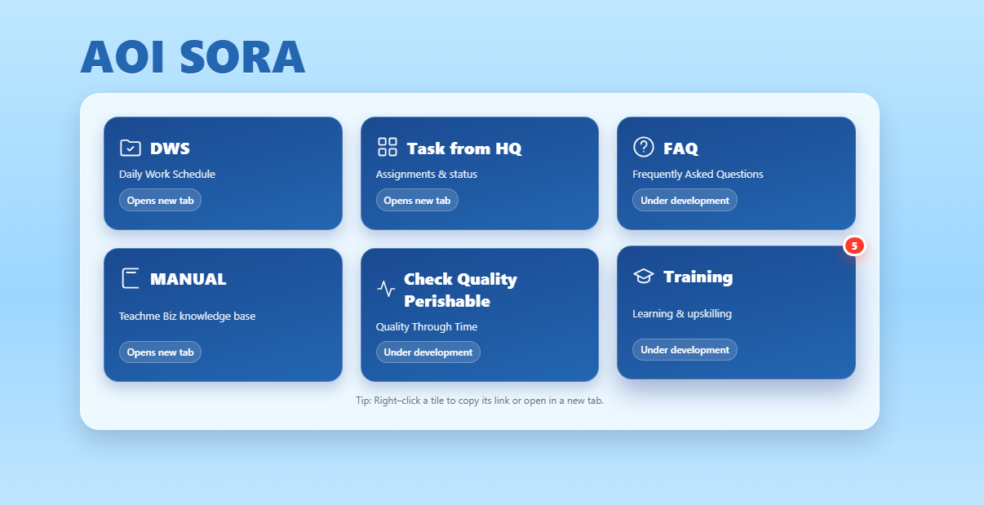
III. AOI SORA
1. Overview

Slide 8
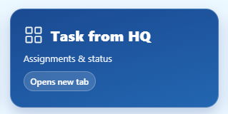
III. AOI SORA
2. Schedule
GO-LIVE
OCT
NOV
DEC
JAN
MAR
2 MONTH: DEVELOPE

Slide 9
III. AOI SORA
3. Cost
① CAPEX
550 MIL VND
② OPEX
144 MIL VND/30 STORE/YEARS

Slide 10
THANK YOU !!!

